Slide 1



Student TradeHub
Group 5
Group Members
Olaiya Oluwatomisin
202580313
Labib Islam
202580788
Nafiur Rahman
202584000
Anya Anya
202580440
Md Minhajul Abedin
202483033
Yi Zhang
202580740
Yixuan Liu
202581744

Slide 2
Student TradeHub
Group 5
Problem Statement
Group Members
Olaiya Oluwatomisin
202580313
Labib Islam
202580788
Nafiur Rahman
202584000
Anya Anya
202580440
Md Minhajul Abedin
202483033
Yi Zhang
202580740
Yixuan Liu
202581744

Slide 3



Problem Statement
Proposed Solution
Student TradeHub
Group 5
No existing marketplace or trading platform for students at Memorial University (or similar institutions).
Group Members
Students risk scams when using open/public platforms.
Olaiya Oluwatomisin
202580313
Labib Islam
202580788
Nafiur Rahman
202584000
Anya Anya
202580440
Lack of a trusted and affordable system for students to buy, sell, and trade items within their community
Md Minhajul Abedin
202483033
Yi Zhang
202580740
Yixuan Liu
202581744

Slide 4
Problem Statement
No existing marketplace or trading platform for students at Memorial University (or similar institutions).
Proposed Solution
Authentication & Login (Student-only access via MUN email/ID)
CRUD Operations – for items, services, and user profiles
Search, Filter & Categorize Items – by price, category, or condition.
Transaction History, Purchase & Payment – record and track purchases securely.
Admin Functions – monitor listings and manage user access.
Order tracking system.
Reviews & ratings for sellers and buyers.
Students risk scams when using open/public platforms.
Lack of a trusted and affordable system for students to buy, sell, and trade items within their community

Slide 5
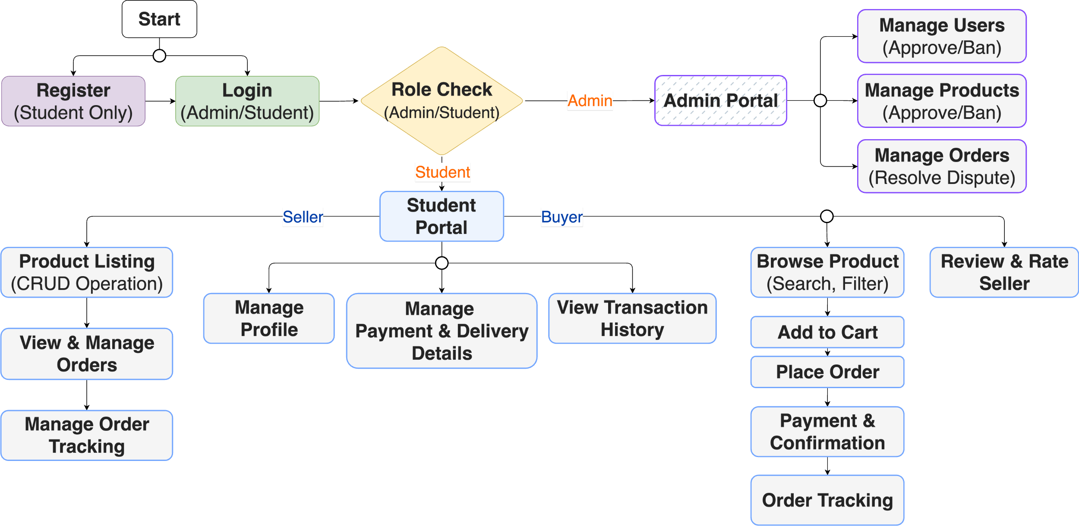
System Flow

Slide 6
Tech Stack
Frontend
Backend
Database
Version Control

Slide 7

Tech Stack
Frontend
Backend
Database
NextJS
Tailwind CSS
Version Control

Slide 8

Tech Stack
Frontend
Backend
Database
NextJS
Tailwind CSS
NodeJS (Framework: ExpressJS)
Version Control

Slide 9

Tech Stack
Frontend
Backend
Database
NextJS
Tailwind CSS
MongoDB (Shared database access for the group)
NodeJS (Framework: ExpressJS)
Version Control

Slide 10

Tech Stack
Frontend
Backend
Database
NextJS
Tailwind CSS
MongoDB (Shared database access for the group)
NodeJS (Framework: ExpressJS)
Version Control
GitHub

Slide 11
Backend
NodeJS (Framework: ExpressJS)
Timeline / Roadmap
Weeks 1–3: Planning and architecture
Weeks 4–7: Core feature development (MVP)
Weeks 8–10: UI/UX improvements, secondary features, error handling
Weeks 11–12: Documentation, polish, usability
Week 13: Final submission & presentation
Frontend
Database
NextJS
Tailwind CSS
MongoDB (Shared database access for the group)
Version Control
GitHub

Slide 12
Expected Outcome
A functional student-only trading platform with core features implemented.
Secure authentication using MUN ID and Email.
Transaction system with purchase history.
Working prototype ready for demonstration and further enhancement.
Documentation and user manual.

Slide 13
!
Conclusion
Thank You
Student TradeHub offers a safe, affordable, and exclusive platform for students to buy, sell, and trade.
Builds trust by keeping the ecosystem student-only.
Scalable foundation for future expansion (reviews, delivery, auctions).

Slide 14
Conclusion
Thank You
!
Student TradeHub offers a safe, affordable, and exclusive platform for students to buy, sell, and trade.
Builds trust by keeping the ecosystem student-only.
Scalable foundation for future expansion (reviews, delivery, auctions).

